Slide 1
The Algol Family and Haskell
Bo Li
Xi’an Jiaotong University
Feb,2020

Slide 2
Module 1 First Step
Glasgow Haskell Compiler

Slide 3
GHC is the leading implementation of Haskell, and comprises a compiler and interpreter;
The interactive nature of the interpreter makes it well suited for teaching and prototyping;
GHC is freely available from:
www.haskell.org/platform

Slide 4
Starting GHCi
The interpreter can be started from the terminal command prompt $ by simply typing ghci:
$ ghci
GHCi, version X: http://www.haskell.org/ghc/ :? for help
Prelude>
The GHCi prompt > means that the interpreter is now ready to evaluate an expression.

Slide 5
For example, it can be used as a desktop calculator to evaluate simple numeric expresions:
> 2+3*4
14
> (2+3)*4
20
> sqrt (3^2 + 4^2)
5.0

Slide 6
The Standard Prelude
Haskell comes with a large number of standard library functions. In addition to the familiar numeric functions such as + and *, the library also provides many useful functions on lists.
Select the first element of a list:
> head [1,2,3,4,5]
1

Slide 7
Remove the first element from a list:
> tail [1,2,3,4,5]
[2,3,4,5]
Select the nth element of a list:
> [1,2,3,4,5] !! 2
3
Select the first n elements of a list:
> take 3 [1,2,3,4,5]
[1,2,3]

Slide 8
Remove the first n elements from a list:
> drop 3 [1,2,3,4,5]
[4,5]
Calculate the length of a list:
> length [1,2,3,4,5]
5
Calculate the sum of a list of numbers:
> sum [1,2,3,4,5]
15

Slide 9
Calculate the product of a list of numbers:
> product [1,2,3,4,5]
120
Append two lists:
> [1,2,3] ++ [4,5]
[1,2,3,4,5]
Reverse a list:
> reverse [1,2,3,4,5]
[5,4,3,2,1]

Slide 10
Function Application
In mathematics, function application is denoted using parentheses, and multiplication is often denoted using juxtaposition or space.
f(a,b) + c d
Apply the function f to a and b, and add the result to the product of c and d.

Slide 11
In Haskell, function application is denoted using space, and multiplication is denoted using *.
f a b + c*d
As previously, but in Haskell syntax.

Slide 12
Moreover, function application is assumed to have higher priority than all other operators.
f a + b
Means (f a) + b, rather than f (a + b).

Slide 13
Examples
Mathematics
Haskell
f(x)
f x
f(x,y)
f x y
f(g(x))
f (g x)
f(x,g(y))
f x (g y)
f(x)g(y)
f x * g y

Slide 14
Haskell Scripts
As well as the functions in the standard library, you can also define your own functions;
New functions are defined within a script, a text file comprising a sequence of definitions;
By convention, Haskell scripts usually have a .hs suffix on their filename. This is not mandatory, but is useful for identification purposes.

Slide 15
My First Script
When developing a Haskell script, it is useful to keep two windows open, one running an editor for the script, and the other running GHCi.
Start an editor, type in the following two function definitions, and save the script as test.hs:
double x = x + x
quadruple x = double (double x)

Slide 16
Leaving the editor open, in another window start up GHCi with the new script:
$ ghci test.hs
Now both the standard library and the file test.hs are loaded, and functions from both can be used:
> quadruple 10
40
> take (double 2) [1,2,3,4,5,6]
[1,2,3,4]

Slide 17
Leaving GHCi open, return to the editor, add the following two definitions, and resave:
factorial n = product [1..n]
average ns = sum ns `div` length ns
Note:
div is enclosed in back quotes, not forward;
x `f` y is just syntactic sugar for f x y.

Slide 18
GHCi does not automatically detect that the script has been changed, so a reload command must be executed before the new definitions can be used:
> :reload
Reading file "test.hs"
> factorial 10
3628800
> average [1,2,3,4,5]
3

Slide 19
Useful GHCi Commands
Command Meaning
:load name load script name
:reload reload current script
:set editor name set editor to name
:edit name edit script name
:edit edit current script
:type expr show type of expr
:? show all commands
:quit quit GHCi

Slide 20
Naming Requirements
Function and argument names must begin with a lower-case letter. For example:
myFun
fun1
arg_2
x’
By convention, list arguments usually have an s suffix on their name. For example:
xs
ns
nss

Slide 21
The Layout Rule
In a sequence of definitions, each definition must begin in precisely the same column:
a = 10
b = 20
c = 30
a = 10
b = 20
c = 30
a = 10
b = 20
c = 30

Slide 22
The layout rule avoids the need for explicit syntax to indicate the grouping of definitions.
a = b + c
where
b = 1
c = 2
d = a * 2
a = b + c
where
{b = 1;
c = 2}
d = a * 2
means
implicit grouping
explicit grouping

Slide 23
Homework
(1)
(2)
Try out slides 2-7 and 13-16 using GHCi.
Fix the syntax errors in the program below, and test your solution using GHCi.
N = a ’div’ length xs
where
a = 10
xs = [1,2,3,4,5]

Slide 24
(3)
Show how the library function last that selects the last element of a list can be defined using the functions introduced in this lecture.
(4)
Can you think of another possible definition?
(5)
Similarly, show how the library function init that removes the last element from a list can be defined in two different ways.

Slide 25
(6)
8 Queens problem?
main = print $ queens 8
boardSize = 8
queens 0 = [[]]
queens n = [ x : y | y <- queens (n-1), x <- [1..boardSize], safe x y 1]
where
safe x [] n = True
safe x (c:y) n = and [ x /= c , x /= c + n , x /= c - n , safe x y (n+1)]

Slide 26
winhugs
1.:e qsort.hs
2. 在notepad中输入并存盘
qsort [] = []
qsort (x:xs) = qsort less ++ [x] ++ qsort more
where less = [y | y <- xs, y < x]
more = [y | y <- xs, y >= x]
3.:l qsort.hs
4. Qsort [12,34,9,1,323]

Slide 27
Interactive Interpretor (ghci):
  read-eval-print
  ghci infers type before compiling or executing
  Type system does not allow casts or other loopholes!
Examples
  Prelude> (5+3)-2
  6
  it :: Integer
  Prelude> if 5>3 then “Harry” else “Hermione”
  “Harry”
  it :: [Char] -- String is equivalent to [Char]
  Prelude> 5==4
  False
  it :: Bool

Slide 28
Module 2
History Review

Slide 29
Crisis
How to deal with the increasing size and complexity of computer programs
  LOC, line of code
  Window 3.1(1992) 3million LOC
  Windows 2000 30-50million LOC
How to reduce the cost of developing and maintaining software
  maintenance can be up to 70%, including understanding, debugging and modifying the code
How to increase our confidence in software correctness
  The European Ariane 5(1996), cost 10 years and $7billion, explode after 40s in its maiden voyage
  the floating point division in the Pentium processor cost Intel around 470 million

Slide 30
Programming Language
One solution is to design a whole new language:
  Programs written:
    simple structure and content
    clear semantics
    high abstraction;
  Support software reuse;
  Support rapid prototyping;
  Provide tools for problem solving;
  Support and encourage formal verification.
The functional programming language achieves the above goals well.
Notes:
一种解决办法是设计一种全新的语言:
编写的程序:结构、内容简洁，语义清晰，具有很高的抽象性；
支持软件的重用；
支持快速原型设计；
提供解决问题的工具；
支持和鼓励形式化验证。
函数程序设计语言较好地到达了上述目标。

Slide 31
Lisp
Algol 60
Algol 68
Pascal
ML
Modula
Haskell
Many other languages:
  Algol 58, Algol W, Euclid, EL1, Mesa (PARC), …
  Modula-2, Oberon, Modula-3 (DEC)
Notes:
It may seem like programming languages never change. That the language you are programming in today is the same as yesterday, and it will always be that way. However, programming languages do change, and have changed quite significantly over the past 50 years. And not just in terms of minor things like syntax! Programming language researchers have made significant strides in developing better programming languages. To appreciate this development, we’re going to spend a little time looking back at some of the languages in use 20 to 50 years ago to see where we’ve come from. We’re also going to spend some time looking at Haskell, which is a programming language at the forefront of language research, ahead of main-stream languages, so you can see where we might be going.

Slide 32


VIP
1920s–1940s:
and
Alonzo Church Haskell Curry
lambda calculus
a function theory and a model for sequential computing.

Slide 33

VIP
1960s:
John McCarthy
develops the first functional language Lisp
  influenced by lambda calculus
  but still with variable assignments.

Slide 34
VIP
David Turner develops Miranda
1988: A committee of prominent researchers publishes the first definition of Haskell, a standard lazy functional language.
1999: The committee publishes the definition of Haskell98

Slide 35
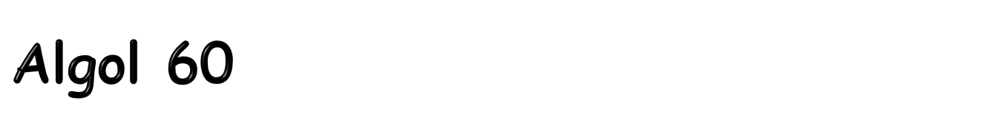
Basic Language of 1960
  Simple imperative language + functions
  Successful syntax, BNF -- used by many successors
    statement oriented
    begin … end blocks (like C { … } )
    if … then … else
  Recursive functions and stack storage allocation
  Fewer ad hoc restrictions than Fortran
    General array references: A[ x + B[3]*y]
  Type discipline was improved by later languages
  Very influential but not widely used in US
Tony Hoare: “Here is a language so far ahead of its time that it was not only an improvement on its predecessors but also on nearly all of its successors.”
Notes:
Tony Hoare is a famous computer scientist, recipient of the Turing award, responsible for the invention of quicksort and Hoare logic for reasoning about programs, among other things.
influential [,influ'enʃəl]
基本翻译
adj. 有影响的；有势力的

Slide 36
real procedure average(A,n);
real array A; integer n;
begin
real sum; sum := 0;
for i = 1 step 1 until n do
sum := sum + A[i];
average := sum/n
end;
no array bounds
no ; here
set procedure return value by assignment

Slide 37
Question:
  Is x := x equivalent to doing nothing?
Interesting answer in Algol
  integer procedure p;
  begin
  ….
  p := p
  ….
  end;
  Assignment here is actually a recursive call
Notes:
Oddity 古怪

Slide 38
Holes in type discipline
  Parameter types can be arrays, but
    No array bounds
  Parameter types can be procedures, but
    No argument or return types for procedure parameters
Problems with parameter passing mechanisms
  Pass-by-name “Copy rule” duplicates code, interacting badly with side effects
  Pass-by-value expensive for arrays
Some awkward control issues
  goto out of block requires memory management

Slide 39
Substitute text of actual parameter
  Unpredictable with side effects!
Example
  procedure inc2(i, j);
  integer i, j;
  begin
  i := i+1;
  j := j+1
  end;
  inc2 (k, A[k]);
  begin
  k := k+1;
  A[k] := A[k] +1
  end;
Is this what you expected?

Slide 40
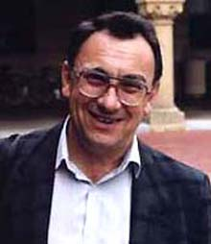
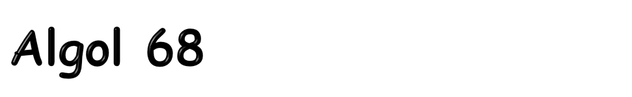
Considered difficult to understand
  Idiosyncratic terminology
    Types were called “modes”
    Arrays were called “multiple values”
  Used vW grammars instead of BNF
    Context-sensitive grammar invented by van Wijngaarden
  Elaborate type system
  Complicated type conversions
Fixed some problems of Algol 60
  Eliminated pass-by-name
Not widely adopted
Notes:
Idiosyncratic：特殊的

Slide 41
Primitive modes
  int
  real
  char
  bool
  string
  compl (complex)
  bits
  bytes
  sema (semaphore)
  format (I/O)
  file
Compound modes
  arrays
  structures
  procedures
  sets
  pointers
Rich, structured, and orthogonal type system is a major contribution of Algol 68.

Slide 42
Storage management
  Local storage on stack
  Heap storage, explicit alloc, and garbage collection
Parameter passing
  Pass-by-value
  Use pointer types to obtain pass-by-reference
Assignable procedure variables
  Follow “orthogonality” principle rigorously
Source: Tanenbaum, Computing Surveys
Notes:
assignable [ə,sainəbl]
基本翻译
adj. [经] 可分配的；可指定的；可让渡的
网络释义
assignable:可转让的 | 可分配的 | 不可忽视
orthogonality [,ɔ:θɔɡə'næləti]
基本翻译
n. [数] 正交性；相互垂直
网络释义
orthogonality:正交性 | 正交 | 相互垂直

Slide 43

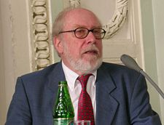
Designed by Niklaus Wirth (Turing Award)
Revised the type system of Algol
  Good data-structuring concepts
    records, variants, subranges
  More restrictive than Algol 60/68
    Procedure parameters cannot have procedure parameters
Popular teaching language
Simple one-pass compiler
Niklaus Wirth

Slide 44
illegal
Array bounds part of type
  procedure p(a : array [1..10] of integer)
  procedure p(n: integer, a : array [1..n] of integer)
  Attempt at orthogonal design backfires
    Parameter must be given a type
    Type cannot contain variables
  How could this have happened? Emphasis on teaching?
Not successful for “industrial-strength” projects
  Kernighan: “Why Pascal is not my favorite language”
  Left niche for C; niche has expanded!!
Notes:
backfire ['bæk,faiə]
基本翻译
vi. 放出逆火；预先放火；产生出乎意料及事与愿违的结果
n. 逆火，回火
网络释义
backfire:回火 | 逆火 | 产生反效果

Slide 45
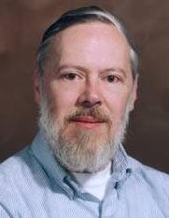
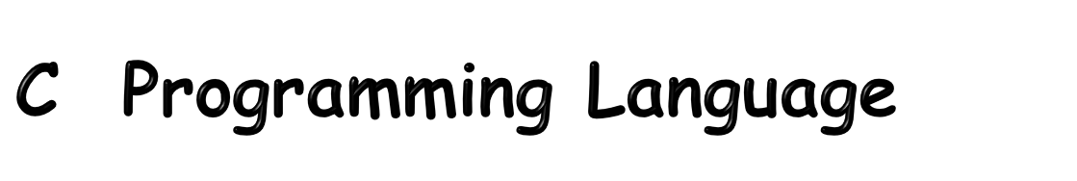
Designed by Dennis Ritchie, Turing Award winner, for writing Unix
Evolved from B, which was based on BCPL
  B was an untyped language; C adds some checking
Relationship between arrays and pointers
  An array is treated as a pointer to first element
  E1[E2] is equivalent to ptr dereference: *((E1)+(E2))
  Pointer arithmetic is not common in other languages
Ritchie quote
  “C is quirky, flawed, and a tremendous success.”
Notes:
quirky ['kwə:ki]
基本翻译
adj. 古怪的；离奇的；诡诈的
flawed [flɔ:d]
基本翻译
adj. 有缺陷的；有瑕疵的；有裂纹的

Slide 46

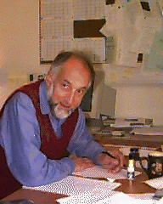
Statically typed, general-purpose programming language
Type safe!
Intended for interactive use
Combination of Lisp and Algol-like features
  Expression-oriented
  Higher-order functions
  Garbage collection
  Abstract data types
  Module system
  Exceptions
Designed by Turing-Award winner Robin Milner for LCF theorem prover
Used in textbook as example language

Slide 47
Late 1960s: Peter Landin develops ISWIM, the first pure functional language, based strongly on lambda calculus
1978 John Backus publishes FP, a functional language that emphasized high-order functions and calculating with programs.
Mid1970s: Robin Milner develops ML, the first of the modern functional languages, which introduced type inference and polymorphic types.

Slide 48

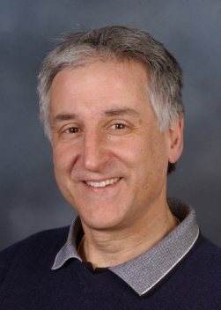
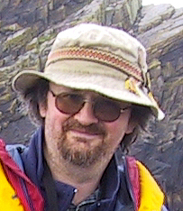

Haskell is a programming language that is
  Similar to ML: general-purpose, strongly typed, higher-order, functional, supports type inference, supports interactive and compiled use
  Different from ML: lazy evaluation, purely functional, rapidly evolving type system.
Designed by committee in 80’s and 90’s to unify research efforts in lazy languages.
  Haskell 1.0 in 1990, Haskell ‘98, Haskell’ ongoing.
  “A history of Haskell: Being lazy with class” HOPL 3
Paul Hudak
Simon Peyton Jones
Phil Wadler
John Hughes

Slide 49

Historical Background
1987:
An international committee starts the development of Haskell, a standard lazy functional language.

Slide 50
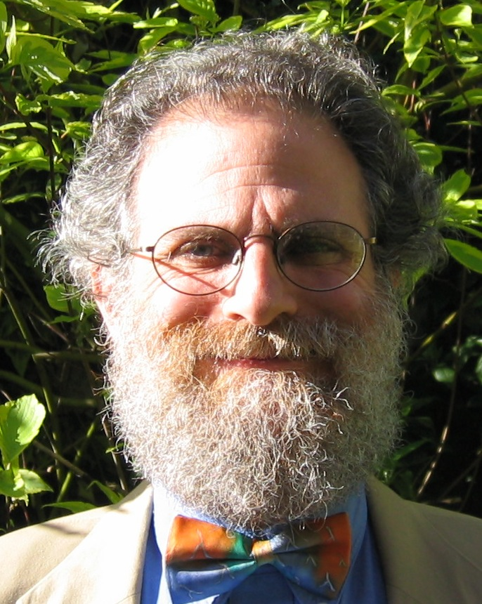
Historical Background
1990s:
Phil Wadler and others develop type classes and monads, two of the main innovations of Haskell.

Slide 51
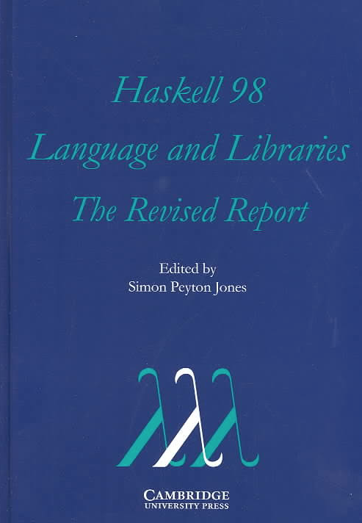
Historical Background
2003:
The committee publishes the Haskell Report, defining a stable version of the language; an updated version was published in 2010.

Slide 52

Historical Background
2010-date:
Standard distribution, library support, new language features, development tools, use in industry, influence on other languages, etc.

Slide 53
Module 3
Why study Haskell?

Slide 54
What is a Functional Language?
Opinions differ, and it is difficult to give a precise definition, but generally speaking:
Functional programming is style of programming in which the basic method of computation is the application of functions to arguments;
A functional language is one that supports and encourages the functional style.

Slide 55
Example
Summing the integers 1 to 10 in Java:
int total = 0;
for (int i = 1; i ≤ 10; i++)
total = total + i;
The computation method is variable assignment.

Slide 56
Example
Summing the integers 1 to 10 in Haskell:
sum [1..10]
The computation method is function application.

Slide 57
Good vehicle for studying language concepts
  Types and type checking
    General issues in static and dynamic typing
    Type inference
    Polymorphism and generic programming
  Control
    Lazy vs. eager evaluation
    Tail recursion and continuations
    Precise management of effects
Notes:
Type inference
类型推断
continuations
基本翻译
n. 延续部分；（书籍的）附录；（文学作品的）续集（continuation的复数）
网络释义
continuations:延拓

Slide 58
Functional programming will make you think differently about programming.
  Mainstream languages are all about state
  Functional programming is all about values
Ideas will make you a better programmer in whatever language you regularly use.
Haskell is “cutting edge.” A lot of current research is done in the context of Haskell.
Notes:
cutting edge
基本翻译
剪刃，[机] 切削刃；刀刃，刀口
网络释义
cutting edge:尖锐 | 尖刻 | 先锋地位

Slide 59
1,000,000
Practitioners
10,000
100
The quick death
Geeks
1
1yr
5yr
10yr
15yr

Slide 60

1,000,000
Practitioners
10,000
100
The slow death
Geeks
1
1yr
5yr
10yr
15yr

Slide 61
Threshold of immortality
1,000,000
Practitioners
10,000
The complete absence of death
100
Geeks
1
1yr
5yr
10yr
15yr
Notes:
of immortality
不朽

Slide 62
“Learning Haskell is a great way of training yourself to think functionally so you are ready to take full advantage of C# 3.0 when it comes out”
(blog Apr 2007)
“I'm already looking at coding problems and my mental perspective is now shifting back and forth between purely OO and more FP styled solutions”
(blog Mar 2007)
1,000,000
Practitioners
10,000
100
The second life?
Geeks
1
1990
1995
2000
2005
2010

Slide 63
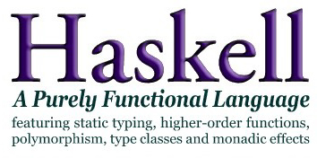

Slide 64
Different Thinking
Functional programming is based on a programming concept that is different from other programming languages:
  a program is a function from input to output, and the execution of the program is the calculation of expressions, not the execution of commands.
C, Java, Ada and Pascal are imperative languages:
  A program is a sequence of commands, and the commands are executed sequentially when the program is run.
  Focus: How to do calculations.
A function program defines how to convert input data to output data.
  It is an expression: the program is run by evaluating expressions.
  Focus: What to calculate.
Let the machine do machine’s work and let the human do human’s work.

Slide 65
Quick Sort
qsort [] = []
qsort (x:xs) = qsort less ++ [x] ++ qsort more
where less = [y | y <- xs, y < x]
more = [y | y <- xs, y >= x]
Concise and beautiful.
Easy to understand
Notes:
在winhugs
1.:e qsort.hs
2. 在notepad中输入并存盘
qsort [] = []
qsort (x:xs) = qsort less ++ [x] ++ qsort more
where less = [y | y <- xs, y < x]
more = [y | y <- xs, y >= x]
3.:l qsort.hs
4. Qsort [12,34,9,1,323]

Slide 66
Features of functional programming
No side effects and fewer errors.
  The result of a function (no side effect) is determined by its input, and only by its input.
  The result doesn’t depend on the evaluation order.
  This eliminates a whole class of bugs in imperative languages.
Strong Type
  It is impossible to apply a function to a boolean when you should apply it to an int.
  Bugs are caught at compile-time, rather than run-time.
  This also makes it less bug.
Notes:
eliminates
基本翻译
消除
排除
网络释义
eliminates:减少 | 消除 | 除去

Slide 67
Code reuse:
  Polymorphism enhance reusability.
  For example, qsort can be used to lists of int, lists of double,
  lists of any type that has < and >= defined.
Module:
  A good programming language support modular programming, and this requires good glue.
  Functional programming provides two kinds of glue- higher order functions and lazy evaluation.

Slide 68
Higher order function
  A higher order function can takes functions as arguments and return a function.
Lazy evaluation
  Non-strict functional languages have another powerful feature: they only evaluate as much of the program as is required to get the answer - this is called lazy evaluation.
See “Why functional programming matter?”

Slide 69
Module 4
Haskell Overview

Slide 70
Basic Types
  Unit
  Booleans
  Integers
  Strings
  Reals
  Tuples
  Lists
  Records
Patterns
Declarations
Functions
Polymorphism
Type declarations
Type Classes
Monads
Exceptions

Slide 71
Types and Classes

Slide 72
What is a Type?
A type is a name for a collection of related values. For example, in Haskell the basic type
Bool
contains the two logical values:
False
True

Slide 73
Type Errors
Applying a function to one or more arguments of the wrong type is called a type error.
> 1 + False
error ...
1 is a number and False is a logical value, but + requires two numbers.

Slide 74
Types in Haskell
If evaluating an expression e would produce a value of type t, then e has type t, written
e :: t
Every well formed expression has a type, which can be automatically calculated at compile time using a process called type inference.

Slide 75
All type errors are found at compile time, which makes programs safer and faster by removing the need for type checks at run time.
In GHCi, the :type command calculates the type of an expression, without evaluating it:
> not False
True
> :type not False
not False :: Bool

Slide 76
Basic Types
Haskell has a number of basic types, including:
Bool
- logical values
Char
- single characters
String
- strings of characters
Int
- fixed-precision integers
Integer
- arbitrary-precision integers
Float
- floating-point numbers

Slide 77
List Types
A list is sequence of values of the same type:
[False,True,False] :: [Bool]
[’a’,’b’,’c’,’d’] :: [Char]
In general:
[t] is the type of lists with elements of type t.

Slide 78
Note:
The type of a list says nothing about its length:
[False,True] :: [Bool]
[False,True,False] :: [Bool]
The type of the elements is unrestricted. For example, we can have lists of lists:
[[’a’],[’b’,’c’]] :: [[Char]]

Slide 79
Tuple Types
A tuple is a sequence of values of different types:
(False,True) :: (Bool,Bool)
(False,’a’,True) :: (Bool,Char,Bool)
In general:
(t1,t2,…,tn) is the type of n-tuples whose ith components have type ti for any i in 1…n.

Slide 80
Note:
The type of a tuple encodes its size:
(False,True) :: (Bool,Bool)
(False,True,False) :: (Bool,Bool,Bool)
The type of the components is unrestricted:
(’a’,(False,’b’)) :: (Char,(Bool,Char))
(True,[’a’,’b’]) :: (Bool,[Char])

Slide 81
Function Types
A function is a mapping from values of one type to values of another type:
not :: Bool → Bool
even :: Int → Bool
In general:
t1 → t2 is the type of functions that map values of type t1 to values to type t2.

Slide 82
Note:
The arrow → is typed at the keyboard as ->.
The argument and result types are unrestricted. For example, functions with multiple arguments or results are possible using lists or tuples:
add :: (Int,Int) → Int
add (x,y) = x+y
zeroto :: Int → [Int]
zeroto n = [0..n]

Slide 83
Curried Functions
Functions with multiple arguments are also possible by returning functions as results:
add’ :: Int → (Int → Int)
add’ x y = x+y
add’ takes an integer x and returns a function add’ x. In turn, this function takes an integer y and returns the result x+y.

Slide 84
Note:
add and add’ produce the same final result, but add takes its two arguments at the same time, whereas add’ takes them one at a time:
add :: (Int,Int) → Int
add’ :: Int → (Int → Int)
Functions that take their arguments one at a time are called curried functions, celebrating the work of Haskell Curry on such functions.

Slide 85
Functions with more than two arguments can be curried by returning nested functions:
mult :: Int → (Int → (Int → Int))
mult x y z = x*y*z
mult takes an integer x and returns a function mult x, which in turn takes an integer y and returns a function mult x y, which finally takes an integer z and returns the result x*y*z.

Slide 86
Why is Currying Useful?
Curried functions are more flexible than functions on tuples, because useful functions can often be made by partially applying a curried function.
For example:
add’ 1 :: Int → Int
take 5 :: [Int] → [Int]
drop 5 :: [Int] → [Int]

Slide 87
Currying Conventions
To avoid excess parentheses when using curried functions, two simple conventions are adopted:
The arrow → associates to the right.
Int → Int → Int → Int
Means Int → (Int → (Int → Int)).

Slide 88
As a consequence, it is then natural for function application to associate to the left.
mult x y z
Means ((mult x) y) z.
Unless tupling is explicitly required, all functions in Haskell are normally defined in curried form.

Slide 89
Polymorphic Functions
A function is called polymorphic (“of many forms”) if its type contains one or more type variables.
length :: [a] → Int
For any type a, length takes a list of values of type a and returns an integer.

Slide 90
Note:
Type variables can be instantiated to different types in different circumstances:
> length [False,True]
2
> length [1,2,3,4]
4
a = Bool
a = Int
Type variables must begin with a lower-case letter, and are usually named a, b, c, etc.

Slide 91
Many of the functions defined in the standard prelude are polymorphic. For example:
fst :: (a,b) → a
head :: [a] → a
take :: Int → [a] → [a]
zip :: [a] → [b] → [(a,b)]
id :: a → a

Slide 92
Overloaded Functions
A polymorphic function is called overloaded if its type contains one or more class constraints.
(+) :: Num a ⇒ a -> a -> a
For any numeric type a, (+) takes two values of type a and returns a value of type a.

Slide 93
Note:
Constrained type variables can be instantiated to any types that satisfy the constraints:
> 1 + 2
3
> 1.0 + 2.0
3.0
> ’a’ + ’b’
ERROR
a = Int
a = Float
Char is not a numeric type

Slide 94
Haskell has a number of type classes, including:
Num
- Numeric types
Eq
- Equality types
Ord
- Ordered types
For example:
(+) :: Num a ⇒ a → a → a
(==) :: Eq a ⇒ a → a → Bool
(<) :: Ord a ⇒ a → a → Bool

Slide 95
Hints and Tips
When defining a new function in Haskell, it is useful to begin by writing down its type;
Within a script, it is good practice to state the type of every new function defined;
When stating the types of polymorphic functions that use numbers, equality or orderings, take care to include the necessary class constraints.

Slide 96
Exercises
(1)
What are the types of the following values?
[’a’,’b’,’c’]
(’a’,’b’,’c’)
[(False,’0’),(True,’1’)]
([False,True],[’0’,’1’])
[tail,init,reverse]

Slide 97
What are the types of the following functions?
(2)
second xs = head (tail xs)
swap (x,y) = (y,x)
pair x y = (x,y)
double x = x*2
palindrome xs = reverse xs == xs
twice f x = f (f x)
(3)
Check your answers using GHCi.

Slide 98
Defining Functions

Slide 99
Conditional Expressions
As in most programming languages, functions can be defined using conditional expressions.
abs :: Int → Int
abs n = if n ≥ 0 then n else -n
abs takes an integer n and returns n if it is non-negative and -n otherwise.

Slide 100
Conditional expressions can be nested:
signum :: Int → Int
signum n = if n < 0 then -1 else
if n == 0 then 0 else 1
Note:
In Haskell, conditional expressions must always have an else branch, which avoids any possible ambiguity problems with nested conditionals.

Slide 101
Guarded Equations
As an alternative to conditionals, functions can also be defined using guarded equations.
abs n | n ≥ 0 = n
| otherwise = -n
As previously, but using guarded equations.

Slide 102
Guarded equations can be used to make definitions involving multiple conditions easier to read:
signum n | n < 0 = -1
| n == 0 = 0
| otherwise = 1
Note:
The catch all condition otherwise is defined in the prelude by otherwise = True.

Slide 103
Pattern Matching
Many functions have a particularly clear definition using pattern matching on their arguments.
not :: Bool → Bool
not False = True
not True = False
not maps False to True, and True to False.

Slide 104
Functions can often be defined in many different ways using pattern matching. For example
(&&) :: Bool → Bool → Bool
True && True = True
True && False = False
False && True = False
False && False = False
can be defined more compactly by
True && True = True
_ && _ = False

Slide 105
However, the following definition is more efficient, because it avoids evaluating the second argument if the first argument is False:
True && b = b
False && _ = False
Note:
The underscore symbol _ is a wildcard pattern that matches any argument value.

Slide 106
Patterns are matched in order. For example, the following definition always returns False:
_ && _ = False
True && True = True
Patterns may not repeat variables. For example, the following definition gives an error:
b && b = b
_ && _ = False

Slide 107
List Patterns
Internally, every non-empty list is constructed by repeated use of an operator (:) called “cons” that adds an element to the start of a list.
[1,2,3,4]
Means 1:(2:(3:(4:[]))).

Slide 108
Functions on lists can be defined using x:xs patterns.
head :: [a] → a
head (x:_) = x
tail :: [a] → [a]
tail (_:xs) = xs
head and tail map any non-empty list to its first and remaining elements.

Slide 109
Note:
x:xs patterns only match non-empty lists:
> head []
*** Exception: empty list
x:xs patterns must be parenthesised, because application has priority over (:). For example, the following definition gives an error:
head x:_ = x

Slide 110
Lambda Expressions
Functions can be constructed without naming the functions by using lambda expressions.
λx → x + x
the nameless function that takes a number x and returns the result x + x.

Slide 111
Note:
The symbol λ is the Greek letter lambda, and is typed at the keyboard as a backslash \.
In mathematics, nameless functions are usually denoted using the  symbol, as in x  x + x.
In Haskell, the use of the λ symbol for nameless functions comes from the lambda calculus, the theory of functions on which Haskell is based.

Slide 112
Why Are Lambda's Useful?
Lambda expressions can be used to give a formal meaning to functions defined using currying.
For example:
add x y = x + y
means
add = λx → (λy → x + y)

Slide 113
Lambda expressions are also useful when defining functions that return functions as results.
For example:
const :: a → b → a
const x _ = x
is more naturally defined by
const :: a → (b → a)
const x = λ_ → x

Slide 114
Lambda expressions can be used to avoid naming functions that are only referenced once.
For example:
odds n = map f [0..n-1]
where
f x = x*2 + 1
can be simplified to
odds n = map (λx → x*2 + 1) [0..n-1]

Slide 115
Operator Sections
An operator written between its two arguments can be converted into a curried function written before its two arguments by using parentheses.
For example:
> 1+2
3
> (+) 1 2
3

Slide 116
This convention also allows one of the arguments of the operator to be included in the parentheses.
For example:
> (1+) 2
3
> (+2) 1
3
In general, if ⊕ is an operator then functions of the form (⊕), (x⊕) and (⊕y) are called sections.

Slide 117
Why Are Sections Useful?
Useful functions can sometimes be constructed in a simple way using sections. For example:
(1+)
- successor function
(1/)
- reciprocation function
(*2)
- doubling function
(/2)
- halving function

Slide 118
Exercises
(1)
Consider a function safetail that behaves in the same way as tail, except that safetail maps the empty list to the empty list, whereas tail gives an error in this case. Define safetail using:
(a) a conditional expression;
(b) guarded equations;
(c) pattern matching.
Hint: the library function null :: [a] → Bool can be used to test if a list is empty.

Slide 119
(2)
Give three possible definitions for the logical or operator (||) using pattern matching.
(3)
Redefine the following version of (&&) using conditionals rather than patterns:
True && True = True
_ && _ = False
(4)
Do the same for the following version:
True && b = b
False && _ = False

Slide 120
List Comprehensions

Slide 121
Set Comprehensions
In mathematics, the comprehension notation can be used to construct new sets from old sets.
{x² | x ∈ {1...5}}
The set {1,4,9,16,25} of all numbers x² such that x is an element of the set {1…5}.

Slide 122
Lists Comprehensions
In Haskell, a similar comprehension notation can be used to construct new lists from old lists.
[x^2 | x ← [1..5]]
The list [1,4,9,16,25] of all numbers x^2 such that x is an element of the list [1..5].

Slide 123
Note:
The expression x ← [1..5] is called a generator, as it states how to generate values for x.
Comprehensions can have multiple generators, separated by commas. For example:
> [(x,y) | x ← [1,2,3], y ← [4,5]]
[(1,4),(1,5),(2,4),(2,5),(3,4),(3,5)]

Slide 124
Changing the order of the generators changes the order of the elements in the final list:
> [(x,y) | y ← [4,5], x ← [1,2,3]]
[(1,4),(2,4),(3,4),(1,5),(2,5),(3,5)]
Multiple generators are like nested loops, with later generators as more deeply nested loops whose variables change value more frequently.

Slide 125
For example:
> [(x,y) | y ← [4,5], x ← [1,2,3]]
[(1,4),(2,4),(3,4),(1,5),(2,5),(3,5)]
x ← [1,2,3] is the last generator, so the value of the x component of each pair changes most frequently.

Slide 126
Dependant Generators
Later generators can depend on the variables that are introduced by earlier generators.
[(x,y) | x ← [1..3], y ← [x..3]]
The list [(1,1),(1,2),(1,3),(2,2),(2,3),(3,3)]
of all pairs of numbers (x,y) such that x,y are elements of the list [1..3] and y ≥ x.

Slide 127
Using a dependant generator we can define the library function that concatenates a list of lists:
concat :: [[a]] → [a]
concat xss = [x | xs ← xss, x ← xs]
For example:
> concat [[1,2,3],[4,5],[6]]
[1,2,3,4,5,6]

Slide 128
Guards
List comprehensions can use guards to restrict the values produced by earlier generators.
[x | x ← [1..10], even x]
The list [2,4,6,8,10] of all numbers x such that x is an element of the list [1..10] and x is even.

Slide 129
Using a guard we can define a function that maps a positive integer to its list of factors:
factors :: Int → [Int]
factors n =
[x | x ← [1..n], n `mod` x == 0]
For example:
> factors 15
[1,3,5,15]

Slide 130
A positive integer is prime if its only factors are 1 and itself. Hence, using factors we can define a function that decides if a number is prime:
prime :: Int → Bool
prime n = factors n == [1,n]
For example:
> prime 15
False
> prime 7
True

Slide 131
Using a guard we can now define a function that returns the list of all primes up to a given limit:
primes :: Int → [Int]
primes n = [x | x ← [2..n], prime x]
For example:
> primes 40
[2,3,5,7,11,13,17,19,23,29,31,37]

Slide 132
The Zip Function
A useful library function is zip, which maps two lists to a list of pairs of their corresponding elements.
zip :: [a] → [b] → [(a,b)]
For example:
> zip [’a’,’b’,’c’] [1,2,3,4]
[(’a’,1),(’b’,2),(’c’,3)]

Slide 133
Using zip we can define a function returns the list of all pairs of adjacent elements from a list:
pairs :: [a] → [(a,a)]
pairs xs = zip xs (tail xs)
For example:
> pairs [1,2,3,4]
[(1,2),(2,3),(3,4)]

Slide 134
Using pairs we can define a function that decides if the elements in a list are sorted:
sorted :: Ord a ⇒ [a] → Bool
sorted xs = and [x ≤ y | (x,y) ← pairs xs]
For example:
> sorted [1,2,3,4]
True
> sorted [1,3,2,4]
False

Slide 135
Using zip we can define a function that returns the list of all positions of a value in a list:
positions :: Eq a ⇒ a → [a] → [Int]
positions x xs =
[i | (x’,i) ← zip xs [0..], x == x’]
For example:
> positions 0 [1,0,0,1,0,1,1,0]
[1,2,4,7]

Slide 136
String Comprehensions
A string is a sequence of characters enclosed in double quotes. Internally, however, strings are represented as lists of characters.
"abc" :: String
Means [’a’, ’b’, ’c’] :: [Char].

Slide 137
Because strings are just special kinds of lists, any polymorphic function that operates on lists can also be applied to strings. For example:
> length "abcde"
5
> take 3 "abcde"
"abc"
> zip "abc" [1,2,3,4]
[(’a’,1),(’b’,2),(’c’,3)]

Slide 138
Similarly, list comprehensions can also be used to define functions on strings, such counting how many times a character occurs in a string:
count :: Char → String → Int
count x xs = length [x’ | x’ ← xs, x == x’]
For example:
> count ’s’ "Mississippi"
4

Slide 139
Exercises
(1)
A triple (x,y,z) of positive integers is called pythagorean if x² + y² = z². Using a list comprehension, define a function
pyths :: Int → [(Int,Int,Int)]
that maps an integer n to all such triples with components in [1..n]. For example:
> pyths 5
[(3,4,5),(4,3,5)]

Slide 140
(2)
A positive integer is perfect if it equals the sum of all of its factors, excluding the number itself. Using a list comprehension, define a function
perfects :: Int → [Int]
that returns the list of all perfect numbers up to a given limit. For example:
> perfects 500
[6,28,496]

Slide 141
(3)
The scalar product of two lists of integers xs and ys of length n is give by the sum of the products of the corresponding integers:
n-1
∑
(xs_{i} * ys_{i} )
i = 0
Using a list comprehension, define a function that returns the scalar product of two lists.

Slide 142
Recursive Functions

Slide 143
Introduction
As we have seen, many functions can naturally be defined in terms of other functions.
fac :: Int → Int
fac n = product [1..n]
fac maps any integer n to the product of the integers between 1 and n.

Slide 144
Expressions are evaluated by a stepwise process of applying functions to their arguments.
For example:
fac 4
=
product [1..4]
=
product [1,2,3,4]
=
1*2*3*4
=
24

Slide 145
Recursive Functions
In Haskell, functions can also be defined in terms of themselves. Such functions are called recursive.
fac 0 = 1
fac n = n * fac (n-1)
fac maps 0 to 1, and any other integer to the product of itself and the factorial of its predecessor.

Slide 146
For example:
fac 3
=
3 * fac 2
=
3 * (2 * fac 1)
=
3 * (2 * (1 * fac 0))
=
3 * (2 * (1 * 1))
=
3 * (2 * 1)
=
3 * 2
=
6

Slide 147
Note:
fac 0 = 1 is appropriate because 1 is the identity for multiplication: 1*x = x = x*1.
The recursive definition diverges on integers < 0 because the base case is never reached:
> fac (-1)
*** Exception: stack overflow

Slide 148
Why is Recursion Useful?
Some functions, such as factorial, are simpler to define in terms of other functions.
As we shall see, however, many functions can naturally be defined in terms of themselves.
Properties of functions defined using recursion can be proved using the simple but powerful mathematical technique of induction.

Slide 149
Recursion on Lists
Recursion is not restricted to numbers, but can also be used to define functions on lists.
product :: Num a ⇒ [a] → a
product [] = 1
product (n:ns) = n * product ns
product maps the empty list to 1, and any non-empty list to its head multiplied by the product of its tail.

Slide 150
For example:
product [2,3,4]
=
2 * product [3,4]
=
2 * (3 * product [4])
=
2 * (3 * (4 * product []))
=
2 * (3 * (4 * 1))
=
24

Slide 151
Using the same pattern of recursion as in product we can define the length function on lists.
length :: [a] → Int
length [] = 0
length (_:xs) = 1 + length xs
length maps the empty list to 0, and any non-empty list to the successor of the length of its tail.

Slide 152
For example:
length [1,2,3]
=
1 + length [2,3]
=
1 + (1 + length [3])
=
1 + (1 + (1 + length []))
=
1 + (1 + (1 + 0))
=
3

Slide 153
Using a similar pattern of recursion we can define the reverse function on lists.
reverse :: [a] → [a]
reverse [] = []
reverse (x:xs) = reverse xs ++ [x]
reverse maps the empty list to the empty list, and any non-empty list to the reverse of its tail appended to its head.

Slide 154
For example:
reverse [1,2,3]
=
reverse [2,3] ++ [1]
=
(reverse [3] ++ [2]) ++ [1]
=
((reverse [] ++ [3]) ++ [2]) ++ [1]
=
(([] ++ [3]) ++ [2]) ++ [1]
=
[3,2,1]

Slide 155
Multiple Arguments
Functions with more than one argument can also be defined using recursion. For example:
Zipping the elements of two lists:
zip :: [a] → [b] → [(a,b)]
zip [] _ = []
zip _ [] = []
zip (x:xs) (y:ys) = (x,y) : zip xs ys

Slide 156
Remove the first n elements from a list:
drop :: Int → [a] → [a]
drop 0 xs = xs
drop _ [] = []
drop n (_:xs) = drop (n-1) xs
Appending two lists:
(++) :: [a] → [a] → [a]
[] ++ ys = ys
(x:xs) ++ ys = x : (xs ++ ys)

Slide 157
Quicksort
The quicksort algorithm for sorting a list of values can be specified by the following two rules:
The empty list is already sorted;
Non-empty lists can be sorted by sorting the tail values ≤ the head, sorting the tail values > the head, and then appending the resulting lists on either side of the head value.

Slide 158
Using recursion, this specification can be translated directly into an implementation:
qsort :: Ord a ⇒ [a] → [a]
qsort [] = []
qsort (x:xs) =
qsort smaller ++ [x] ++ qsort larger
where
smaller = [a | a ← xs, a ≤ x]
larger = [b | b ← xs, b > x]
Note:
This is probably the simplest implementation of quicksort in any programming language!

Slide 159
For example (abbreviating qsort as q):
q [3,2,4,1,5]
q [2,1]
++ [3] ++
q [4,5]
q [1]
++ [2] ++
q []
q []
++ [4] ++
q [5]
[1]
[]
[]
[5]

Slide 160
Exercises
(1)
Without looking at the standard prelude, define the following library functions using recursion:
Decide if all logical values in a list are true:
and :: [Bool] → Bool
Concatenate a list of lists:
concat :: [[a]] → [a]

Slide 161
Produce a list with n identical elements:
replicate :: Int → a → [a]
Select the nth element of a list:
(!!) :: [a] → Int → a
Decide if a value is an element of a list:
elem :: Eq a ⇒ a → [a] → Bool

Slide 162
(2)
Define a recursive function
merge :: Ord a ⇒ [a] → [a] → [a]
that merges two sorted lists of values to give a single sorted list. For example:
> merge [2,5,6] [1,3,4]
[1,2,3,4,5,6]

Slide 163
(3)
Define a recursive function
msort :: Ord a ⇒ [a] → [a]
that implements merge sort, which can be specified by the following two rules:
Lists of length ≤ 1 are already sorted;
Other lists can be sorted by sorting the two halves and merging the resulting lists.

Slide 164
Higher-Order Functions

Slide 165
Introduction
A function is called higher-order if it takes a function as an argument or returns a function as a result.
twice :: (a → a) → a → a
twice f x = f (f x)
twice is higher-order because it
takes a function as its first argument.

Slide 166
Why Are They Useful?
Common programming idioms can be encoded as functions within the language itself.
Domain specific languages can be defined as collections of higher-order functions.
Algebraic properties of higher-order functions can be used to reason about programs.

Slide 167
  Map: applies argument function to each element in a collection.
  Reduce: takes a collection, an initial value, and a function, and combines the elements in the collection according to the function.
Google uses Map/Reduce to parallelize and distribute massive data processing tasks. (Dean & Ghemawat, OSDI 2004)
  list = [1,2,3]
  r = foldl (\accumulator i -> i + accumulator) 0 list
Notes:
Prelude>foldl(+)0[3,8,12,5]

Slide 168
The Map Function
The higher-order library function called map applies a function to every element of a list.
map :: (a → b) → [a] → [b]
For example:
> map (+1) [1,3,5,7]
[2,4,6,8]

Slide 169
The map function can be defined in a particularly simple manner using a list comprehension:
map f xs = [f x | x ← xs]
Alternatively, for the purposes of proofs, the map function can also be defined using recursion:
map f [] = []
map f (x:xs) = f x : map f xs

Slide 170
The Filter Function
The higher-order library function filter selects every element from a list that satisfies a predicate.
filter :: (a → Bool) → [a] → [a]
For example:
> filter even [1..10]
[2,4,6,8,10]

Slide 171
Filter can be defined using a list comprehension:
filter p xs = [x | x ← xs, p x]
Alternatively, it can be defined using recursion:
filter p [] = []
filter p (x:xs)
| p x = x : filter p xs
| otherwise = filter p xs

Slide 172
The Foldr Function
A number of functions on lists can be defined using the following simple pattern of recursion:
f [] = v
f (x:xs) = x ⊕ f xs
f maps the empty list to some value v, and any non-empty list to some function ⊕ applied to its head and f of its tail.

Slide 173
For example:
sum [] = 0
sum (x:xs) = x + sum xs
v = 0
⊕ = +
product [] = 1
product (x:xs) = x * product xs
v = 1
⊕ = *
and [] = True
and (x:xs) = x && and xs
v = True
⊕ = &&

Slide 174
The higher-order library function foldr (fold right) encapsulates this simple pattern of recursion, with the function ⊕ and the value v as arguments.
For example:
sum = foldr (+) 0
product = foldr (*) 1
or = foldr (||) False
and = foldr (&&) True

Slide 175
Foldr itself can be defined using recursion:
foldr :: (a → b → b) → b → [a] → b
foldr f v [] = v
foldr f v (x:xs) = f x (foldr f v xs)
However, it is best to think of foldr non-recursively, as simultaneously replacing each (:) in a list by a given function, and [] by a given value.

Slide 176
For example:
sum [1,2,3]
=
foldr (+) 0 [1,2,3]
=
foldr (+) 0 (1:(2:(3:[])))
=
1+(2+(3+0))
=
6
Replace each (:)
by (+) and [] by 0.

Slide 177
For example:
product [1,2,3]
=
foldr (*) 1 [1,2,3]
=
foldr (*) 1 (1:(2:(3:[])))
=
1*(2*(3*1))
=
6
Replace each (:)
by (*) and [] by 1.

Slide 178
Other Foldr Examples
Even though foldr encapsulates a simple pattern of recursion, it can be used to define many more functions than might first be expected.
Recall the length function:
length :: [a] → Int
length [] = 0
length (_:xs) = 1 + length xs

Slide 179
For example:
length [1,2,3]
=
length (1:(2:(3:[])))
=
1+(1+(1+0))
=
3
Replace each (:) by λ_ n → 1+n and [] by 0.
Hence, we have:
length = foldr (λ_ n → 1+n) 0

Slide 180
Now recall the reverse function:
reverse [] = []
reverse (x:xs) = reverse xs ++ [x]
For example:
Replace each (:) by λx xs → xs ++ [x] and [] by [].
reverse [1,2,3]
=
reverse (1:(2:(3:[])))
=
(([] ++ [3]) ++ [2]) ++ [1]
=
[3,2,1]

Slide 181
Hence, we have:
reverse = foldr (λx xs → xs ++ [x]) []
Finally, we note that the append function (++) has a particularly compact definition using foldr:
(++ ys) = foldr (:) ys
Replace each (:) by (:) and [] by ys.

Slide 182
Why Is Foldr Useful?
Some recursive functions on lists, such as sum, are simpler to define using foldr.
Properties of functions defined using foldr can be proved using algebraic properties of foldr, such as fusion and the banana split rule.
Advanced program optimisations can be simpler if foldr is used in place of explicit recursion.

Slide 183
Other Library Functions
The library function (.) returns the composition of two functions as a single function.
(.) :: (b → c) → (a → b) → (a → c)
f . g = λx → f (g x)
For example:
odd :: Int → Bool
odd = not . even

Slide 184
The library function all decides if every element of a list satisfies a given predicate.
all :: (a → Bool) → [a] → Bool
all p xs = and [p x | x ← xs]
For example:
> all even [2,4,6,8,10]
True

Slide 185
Dually, the library function any decides if at least
one element of a list satisfies a predicate.
any :: (a → Bool) → [a] → Bool
any p xs = or [p x | x ← xs]
For example:
> any (== ’ ’) "abc def"
True

Slide 186
The library function takeWhile selects elements from a list while a predicate holds of all the elements.
takeWhile :: (a → Bool) → [a] → [a]
takeWhile p [] = []
takeWhile p (x:xs)
| p x = x : takeWhile p xs
| otherwise = []
For example:
> takeWhile (/= ’ ’) "abc def"
"abc"

Slide 187
Dually, the function dropWhile removes elements while a predicate holds of all the elements.
dropWhile :: (a → Bool) → [a] → [a]
dropWhile p [] = []
dropWhile p (x:xs)
| p x = dropWhile p xs
| otherwise = x:xs
For example:
> dropWhile (== ’ ’) " abc"
"abc"

Slide 188
Exercises
(1)
What are higher-order functions that return functions as results better known as?
(2)
Express the comprehension [f x | x ← xs, p x] using the functions map and filter.
(3)
Redefine map f and filter p using foldr.

Slide 189
Declaring Types and Classes

Slide 190
Type Declarations
In Haskell, a new name for an existing type can be defined using a type declaration.
type String = [Char]
String is a synonym for the type [Char].

Slide 191
Type declarations can be used to make other types easier to read. For example, given
type Pos = (Int,Int)
we can define:
origin :: Pos
origin = (0,0)
left :: Pos → Pos
left (x,y) = (x-1,y)

Slide 192
Like function definitions, type declarations can also have parameters. For example, given
type Pair a = (a,a)
we can define:
mult :: Pair Int → Int
mult (m,n) = m*n
copy :: a → Pair a
copy x = (x,x)

Slide 193
Type declarations can be nested:
type Pos = (Int,Int)
type Trans = Pos → Pos
However, they cannot be recursive:
type Tree = (Int,[Tree])

Slide 194
Data Declarations
A completely new type can be defined by specifying its values using a data declaration.
data Bool = False | True
Bool is a new type, with two new values False and True.

Slide 195
Note:
The two values False and True are called the constructors for the type Bool.
Type and constructor names must always begin with an upper-case letter.
Data declarations are similar to context free grammars. The former specifies the values of a type, the latter the sentences of a language.

Slide 196
Values of new types can be used in the same ways as those of built in types. For example, given
data Answer = Yes | No | Unknown
we can define:
answers :: [Answer]
answers = [Yes,No,Unknown]
flip :: Answer → Answer
flip Yes = No
flip No = Yes
flip Unknown = Unknown

Slide 197
The constructors in a data declaration can also have parameters. For example, given
data Shape = Circle Float
| Rect Float Float
we can define:
square :: Float → Shape
square n = Rect n n
area :: Shape → Float
area (Circle r) = pi * r^2
area (Rect x y) = x * y

Slide 198
Note:
Shape has values of the form Circle r where r is a float, and Rect x y where x and y are floats.
Circle and Rect can be viewed as functions that construct values of type Shape:
Circle :: Float → Shape
Rect :: Float → Float → Shape

Slide 199
Not surprisingly, data declarations themselves can also have parameters. For example, given
data Maybe a = Nothing | Just a
we can define:
safediv :: Int → Int → Maybe Int
safediv _ 0 = Nothing
safediv m n = Just (m `div` n)
safehead :: [a] → Maybe a
safehead [] = Nothing
safehead xs = Just (head xs)

Slide 200
Recursive Types
In Haskell, new types can be declared in terms of themselves. That is, types can be recursive.
data Nat = Zero | Succ Nat
Nat is a new type, with constructors Zero :: Nat and Succ :: Nat → Nat.

Slide 201
Note:
A value of type Nat is either Zero, or of the form Succ n where n :: Nat. That is, Nat contains the following infinite sequence of values:
Zero
Succ Zero
Succ (Succ Zero)
•
•
•

Slide 202
We can think of values of type Nat as natural numbers, where Zero represents 0, and Succ represents the successor function 1+.
For example, the value
Succ (Succ (Succ Zero))
represents the natural number
1 + (1 + (1 + 0))
=
3

Slide 203
Using recursion, it is easy to define functions that convert between values of type Nat and Int:
nat2int :: Nat → Int
nat2int Zero = 0
nat2int (Succ n) = 1 + nat2int n
int2nat :: Int → Nat
int2nat 0 = Zero
int2nat n = Succ (int2nat (n-1))

Slide 204
Two naturals can be added by converting them to integers, adding, and then converting back:
add :: Nat → Nat → Nat
add m n = int2nat (nat2int m + nat2int n)
However, using recursion the function add can be defined without the need for conversions:
add Zero n = n
add (Succ m) n = Succ (add m n)

Slide 205
For example:
add (Succ (Succ Zero)) (Succ Zero)
=
Succ (add (Succ Zero) (Succ Zero))
=
Succ (Succ (add Zero (Succ Zero))
=
Succ (Succ (Succ Zero))
Note:
The recursive definition for add corresponds to the laws 0+n = n and (1+m)+n = 1+(m+n).

Slide 206
Arithmetic Expressions
Consider a simple form of expressions built up from integers using addition and multiplication.
+
1
∗
2
3

Slide 207
Using recursion, a suitable new type to represent such expressions can be declared by:
data Expr = Val Int
| Add Expr Expr
| Mul Expr Expr
For example, the expression on the previous slide would be represented as follows:
Add (Val 1) (Mul (Val 2) (Val 3))

Slide 208
Using recursion, it is now easy to define functions that process expressions. For example:
size :: Expr → Int
size (Val n) = 1
size (Add x y) = size x + size y
size (Mul x y) = size x + size y
eval :: Expr → Int
eval (Val n) = n
eval (Add x y) = eval x + eval y
eval (Mul x y) = eval x * eval y

Slide 209
Note:
The three constructors have types:
Val :: Int → Expr
Add :: Expr → Expr → Expr
Mul :: Expr → Expr → Expr
Many functions on expressions can be defined by replacing the constructors by other functions using a suitable fold function. For example:
eval = folde id (+) (*)

Slide 210
Binary Trees
In computing, it is often useful to store data in a two-way branching structure or binary tree.
5
3
7
1
4
6
9

Slide 211
Using recursion, a suitable new type to represent such binary trees can be declared by:
data Tree a = Leaf a
| Node (Tree a) a (Tree a)
For example, the tree on the previous slide would be represented as follows:
t :: Tree Int
t = Node (Node (Leaf 1) 3 (Leaf 4)) 5
(Node (Leaf 6) 7 (Leaf 9))

Slide 212
We can now define a function that decides if a given value occurs in a binary tree:
occurs :: Ord a ⇒ a → Tree a → Bool
occurs x (Leaf y) = x == y
occurs x (Node l y r) = x == y
|| occurs x l
|| occurs x r
But… in the worst case, when the value does not occur, this function traverses the entire tree.

Slide 213
Now consider the function flatten that returns the list of all the values contained in a tree:
flatten :: Tree a → [a]
flatten (Leaf x) = [x]
flatten (Node l x r) = flatten l
++ [x]
++ flatten r
A tree is a search tree if it flattens to a list that is ordered. Our example tree is a search tree, as it flattens to the ordered list [1,3,4,5,6,7,9].

Slide 214
Search trees have the important property that when trying to find a value in a tree we can always decide which of the two sub-trees it may occur in:
occurs x (Leaf y) = x == y
occurs x (Node l y r) | x == y = True
| x < y = occurs x l
| x > y = occurs x r
This new definition is more efficient, because it only traverses one path down the tree.

Slide 215
Exercises
(1)
Using recursion and the function add, define a function that multiplies two natural numbers.
(2)
Define a suitable function folde for expressions, and give a few examples of its use.
(3)
A binary tree is complete if the two sub-trees of every node are of equal size. Define a function that decides if a binary tree is complete.

Slide 216
Interactive Programming

Slide 217
Introduction
To date, we have seen how Haskell can be used to write batch programs that take all their inputs at the start and give all their outputs at the end.
inputs
batch
program
outputs

Slide 218
However, we would also like to use Haskell to write interactive programs that read from the keyboard and write to the screen, as they are running.
keyboard
inputs
interactive
program
outputs
screen

Slide 219
The Problem
Haskell programs are pure mathematical functions:
Haskell programs have no side effects.
However, reading from the keyboard and writing to the screen are side effects:
Interactive programs have side effects.

Slide 220
The Solution
Interactive programs can be written in Haskell by using types to distinguish pure expressions from impure actions that may involve side effects.
IO a
The type of actions that return a value of type a.

Slide 221
For example:
IO Char
The type of actions that return a character.
The type of purely side effecting actions that return no result value.
IO ()
Note:
() is the type of tuples with no components.

Slide 222
Basic Actions
The standard library provides a number of actions, including the following three primitives:
The action getChar reads a character from the keyboard, echoes it to the screen, and returns the character as its result value:
getChar :: IO Char

Slide 223
The action putChar c writes the character c to the screen, and returns no result value:
putChar :: Char → IO ()
The action return v simply returns the value v, without performing any interaction:
return :: a → IO a

Slide 224
Sequencing
A sequence of actions can be combined as a single composite action using the keyword do.
For example:
act :: IO (Char,Char)
act = do x ← getChar
getChar
y ← getChar
return (x,y)

Slide 225
Derived Primitives
Reading a string from the keyboard:
getLine :: IO String
getLine = do x ← getChar
if x == '\n' then
return []
else
do xs ← getLine
return (x:xs)

Slide 226
Writing a string to the screen:
putStr :: String → IO ()
putStr [] = return ()
putStr (x:xs) = do putChar x
putStr xs
Writing a string and moving to a new line:
putStrLn :: String → IO ()
putStrLn xs = do putStr xs
putChar '\n'

Slide 227
Example
We can now define an action that prompts for a string to be entered and displays its length:
strlen :: IO ()
strlen = do putStr "Enter a string: "
xs ← getLine
putStr "The string has "
putStr (show (length xs))
putStrLn " characters"

Slide 228
For example:
> strlen
Enter a string: Haskell
The string has 7 characters
Note:
Evaluating an action executes its side effects, with the final result value being discarded.

Slide 229
Hangman
Consider the following version of hangman:
One player secretly types in a word.
The other player tries to deduce the word, by entering a sequence of guesses.
For each guess, the computer indicates which letters in the secret word occur in the guess.

Slide 230
The game ends when the guess is correct.
We adopt a top down approach to implementing hangman in Haskell, starting as follows:
hangman :: IO ()
hangman = do putStrLn "Think of a word: "
word ← sgetLine
putStrLn "Try to guess it:"
play word

Slide 231
The action sgetLine reads a line of text from the keyboard, echoing each character as a dash:
sgetLine :: IO String
sgetLine = do x ← getCh
if x == '\n' then
do putChar x
return []
else
do putChar '-'
xs ← sgetLine
return (x:xs)

Slide 232
The action getCh reads a single character from the keyboard, without echoing it to the screen:
import System.IO
getCh :: IO Char
getCh = do hSetEcho stdin False
x ← getChar
hSetEcho stdin True
return x

Slide 233
The function play is the main loop, which requests and processes guesses until the game ends.
play :: String → IO ()
play word =
do putStr "? "
guess ← getLine
if guess == word then
putStrLn "You got it!"
else
do putStrLn (match word guess)
play word

Slide 234
The function match indicates which characters in one string occur in a second string:
match :: String → String → String
match xs ys =
[if elem x ys then x else '-' | x ← xs]
For example:
> match "haskell" "pascal"
"-as--ll"

Slide 235
Exercise
Implement the game of nim in Haskell, where the rules of the game are as follows:
The board comprises five rows of stars:
1: * * * * *
2: * * * *
3: * * *
4: * *
5: *

Slide 236
Two players take it turn about to remove one or more stars from the end of a single row.
The winner is the player who removes the last star or stars from the board.
Hint:
Represent the board as a list of five integers that give the number of stars remaining on each row. For example, the initial board is [5,4,3,2,1].

Slide 237
Haskell Parallel

Slide 238
Haskell Parallel
Quite convenient.
  Pure functions are stateless, and locks don't matter.
Control.Parallel
  two functions
  par, which represents two parallel calculations;
  pseq representing continuous calculations.
  divide-and-conquer algorithm is more appropriate.
Notes:
haskell搞并行还是挺方便的。纯函数式没状态嘛，这儿锁啊钥匙啊什么的都不用管了。有个Control.Parallel，里貌似只有两个函数，一个par，表示两个并行计算；一个pseq，表示连续计算。参数都是两个名字。像处理个分治算法啥的，就再合适不过了。于是再次膜拜惰性求值，写起来真的太奇特了。
module Main where import Control.Parallel --the classic one qsort :: (Ord a) => [a] -> [a] qsort [] = [] qsort (x:xs) = (qsort lt) ++ [x] ++ (qsort gt) where lt = filter (<x) xs gt = filter (>=x) xs --the parallel one psort :: (Ord a) => [a] -> [a] psort [] = [] psort (x:xs) = sorted_lt `par` sorted_gt `pseq` (sorted_lt ++ [x] ++ sorted_gt) ----unbelieveable,isn't it? :> where sorted_lt = psort $ filter (<) xs sorted_gt = psort $ filter (>=x) xs main = do { list <- return [5000,4999..1]; print $ qsort list; print $ psort list; }

Slide 239
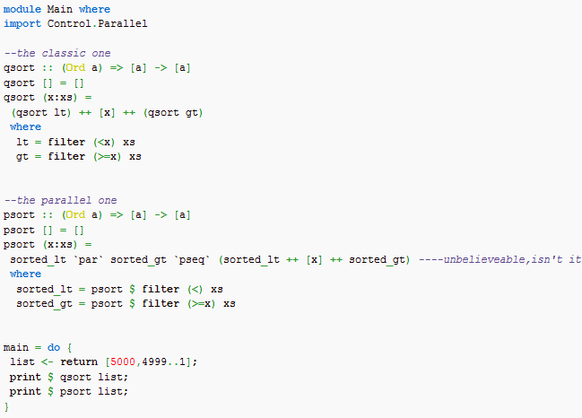
Notes:
import Control.Parallel
main = a `par` b `pseq` print (a + b)
where
a = fac 10
b = fac 20
fac 0 = 1
fac n = n * fac (n - 1)

Slide 240
Test
Under the profile, add a compilation option -prof -O to ghc:
  ghc --make -prof -O -auto-all quicksort.hs
Execute the program, add an option + RTS -p, it will generate a quicksort.prof file in this directory
  quicksort +RTS -p

Slide 241
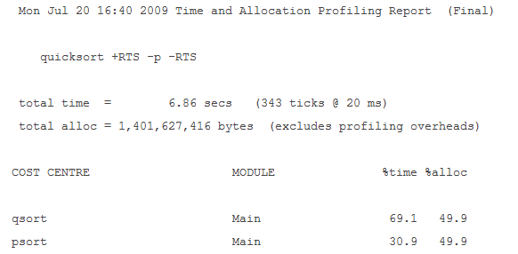
quicksort.prof：
On this dual-core machine, performance has been improved by more than half
Notes:
Mon Jul 20 16:40 2009 Time and Allocation Profiling Report (Final) quicksort +RTS -p -RTS total time = 6.86 secs (343 ticks @ 20 ms) total alloc = 1,401,627,416 bytes (excludes profiling overheads) COST CENTRE MODULE %time %alloc qsort Main 69.1 49.9 psort Main 30.9 49.9 可见在这台双核的机器上，性能提高了一半多

Slide 242
Testing

Slide 243
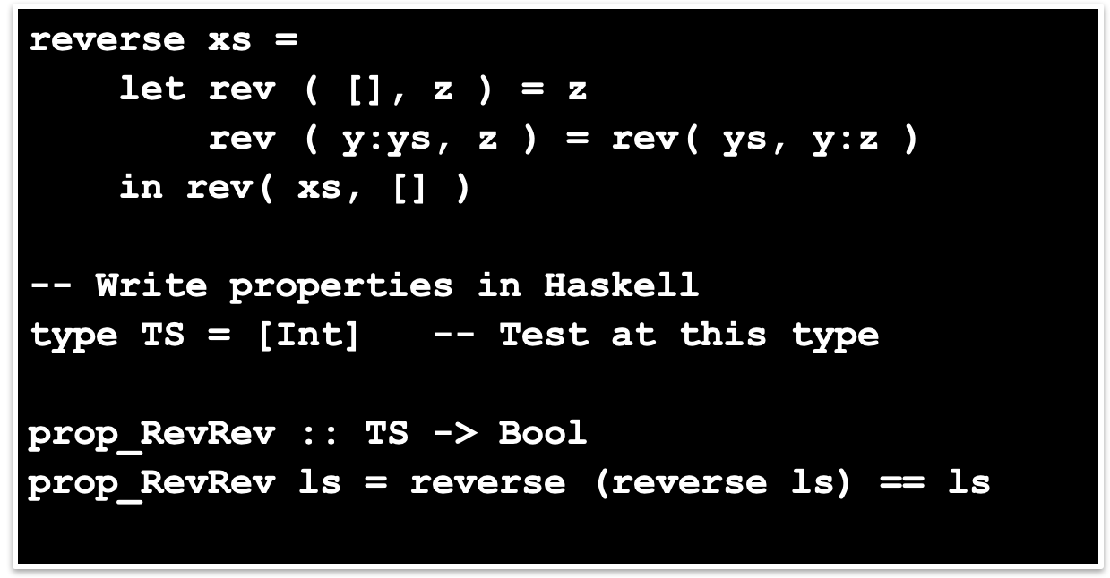
It’s good to write tests as you write code
E.g. reverse undoes itself, etc.

Slide 244
Test.QuickCheck is simply a Haskell library (not a “tool”)
bash$ ghci intro.hs
Prelude> :m +Test.QuickCheck
Prelude Test.QuickCheck> quickCheck prop_RevRev
+++ OK, passed 100 tests
...with a strange-looking type
Prelude Test.QuickCheck> :t quickCheck
quickCheck :: Testable prop => prop -> IO ()
Demo QuickCheck
Notes:
interactively
基本翻译
adv. 交互式地；互勤地
网络释义
interactively:交互式地

Slide 245
No side effects. At all.
A call to reverse returns a new list; the old one is unaffected.
A variable ‘l’ stands for an immutable value, not for a location whose value can change.
Laziness forces this purity.
reverse:: [w] -> [w]
prop_RevRev l = reverse(reverse l) == l

Slide 246
Purity makes the interface explicit.
Takes a list, and returns a list; that’s all.
Takes a list; may modify it; may modify other persistent state; may do I/O.
reverse:: [w] -> [w] -- Haskell
void reverse( list l ) /* C */

Slide 247
Pure functions are easy to test.
In an imperative or OO language, you have to
  set up the state of the object and the external state it reads or writes
  make the call
  inspect the state of the object and the external state
  perhaps copy part of the object or global state, so that you can use it in the postcondition
prop_RevRev l = reverse(reverse l) == l

Slide 248
Types are everywhere.
Usual static-typing panegyric omitted...
In Haskell, types express high-level design, in the same way that UML diagrams do, with the advantage that the type signatures are machine-checked.
Types are (almost always) optional: type inference fills them in if you leave them out.
reverse:: [w] -> [w]
Notes:
panegyric [,pæni'dʒirik] 报错
n. 颂词，赞颂
omitted [əu'mitid]
基本翻译
v. 遗漏，省略（omit的过去分词）
adj. 省略了的；省去的
网络释义
omitted:遗漏 | 忽略的 | 省略了的

Slide 249
The Haskell wikibook
  http://en.wikibooks.org/wiki/Haskell
All the Haskell bloggers, sorted by topic
  http://haskell.org/haskellwiki/Blog_articles
Collected research papers about Haskell
  http://haskell.org/haskellwiki/Research_papers
Wiki articles, by category
  http://haskell.org/haskellwiki/Category:Haskell
Books and tutorials
  http://haskell.org/haskellwiki/Books_and_tutorials

Slide 250
Thanks

